Slide 1
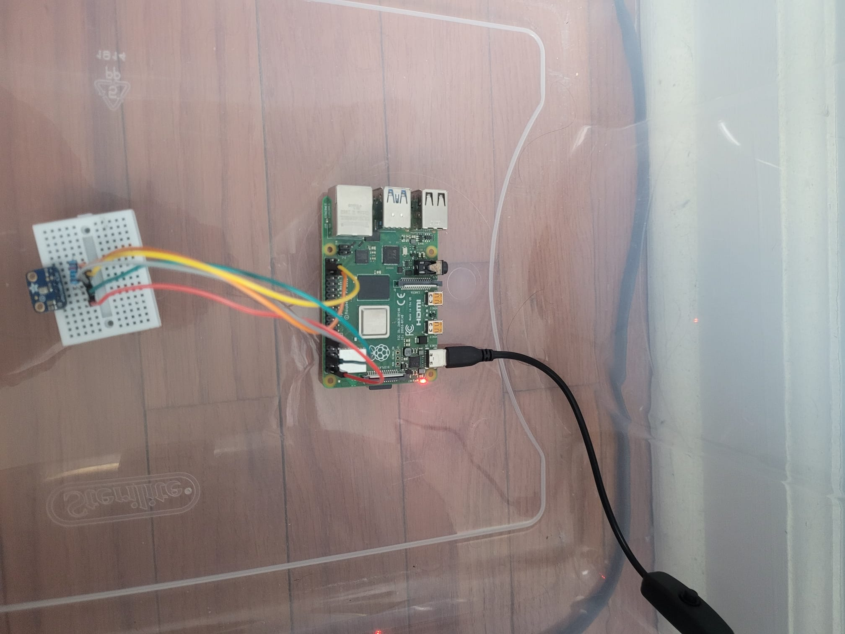
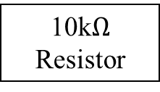
10k$Ω$ Resistor
Raspberry Pi 4
Wall Power Source
I2S MEMS Microphone

Slide 2
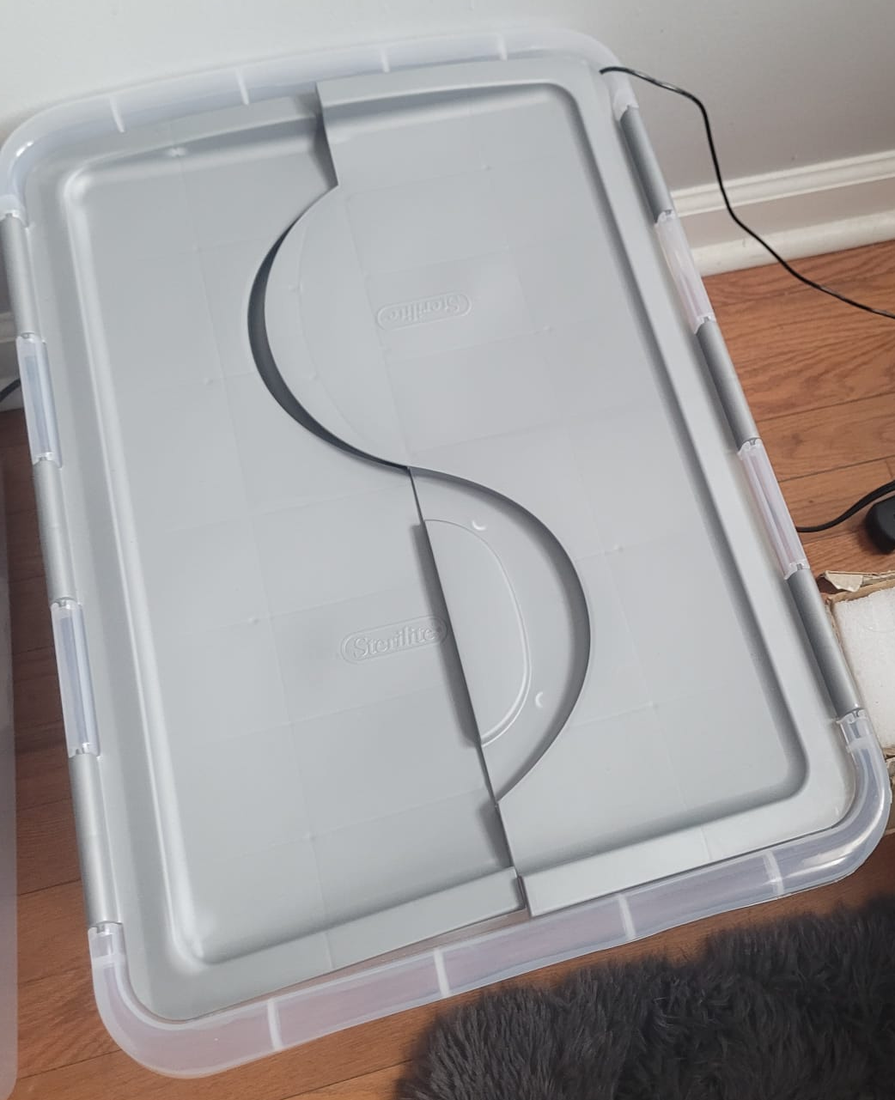
Box with closable lid

Slide 3
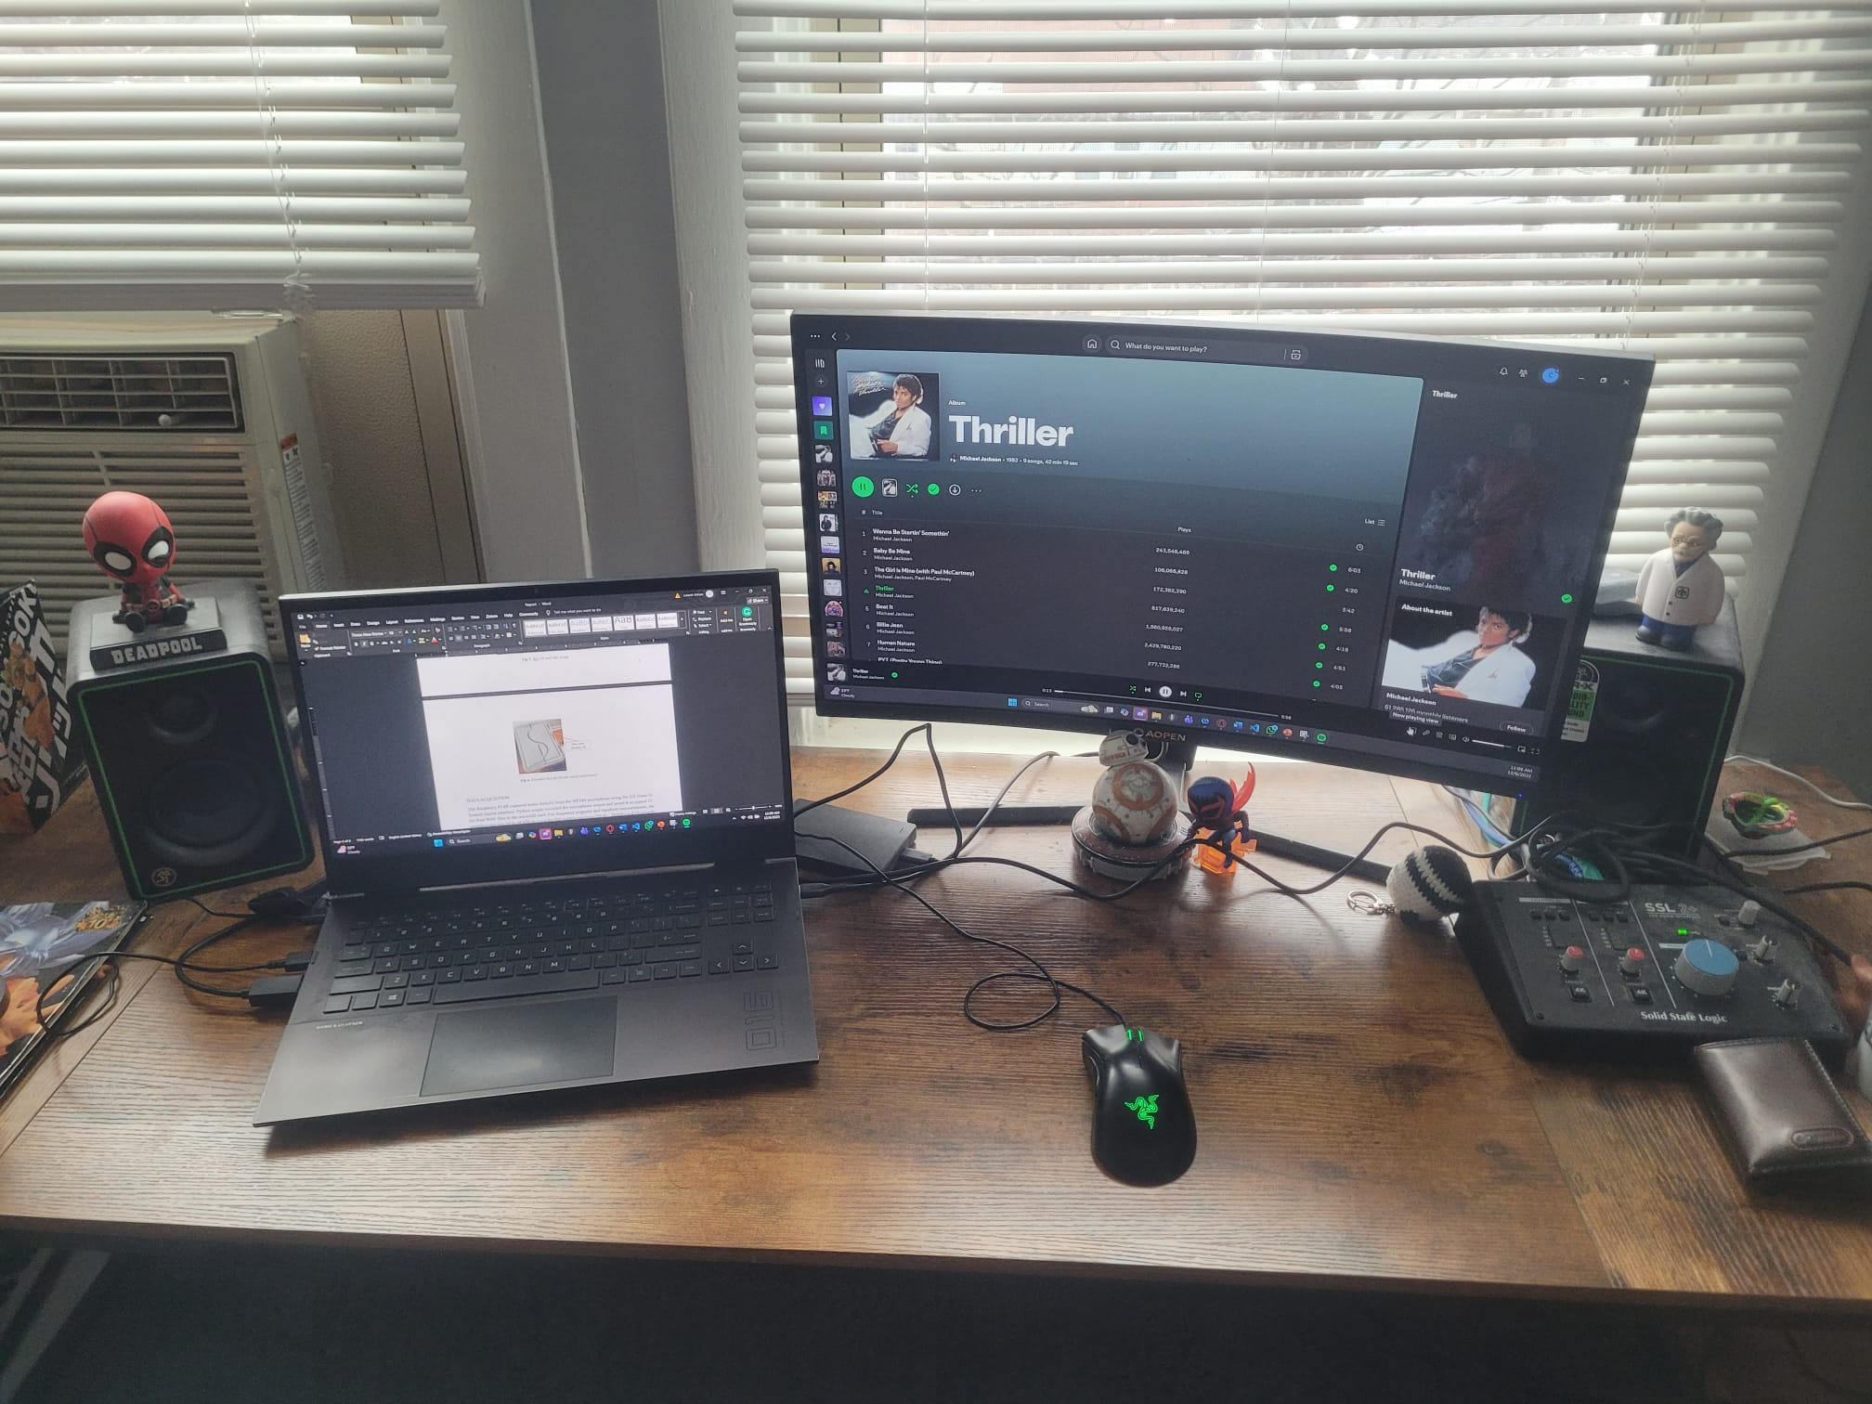
Speakers
Computer

